Slide 1
KINETIC ENERGY AND MOLECULAR SPEED

Slide 3
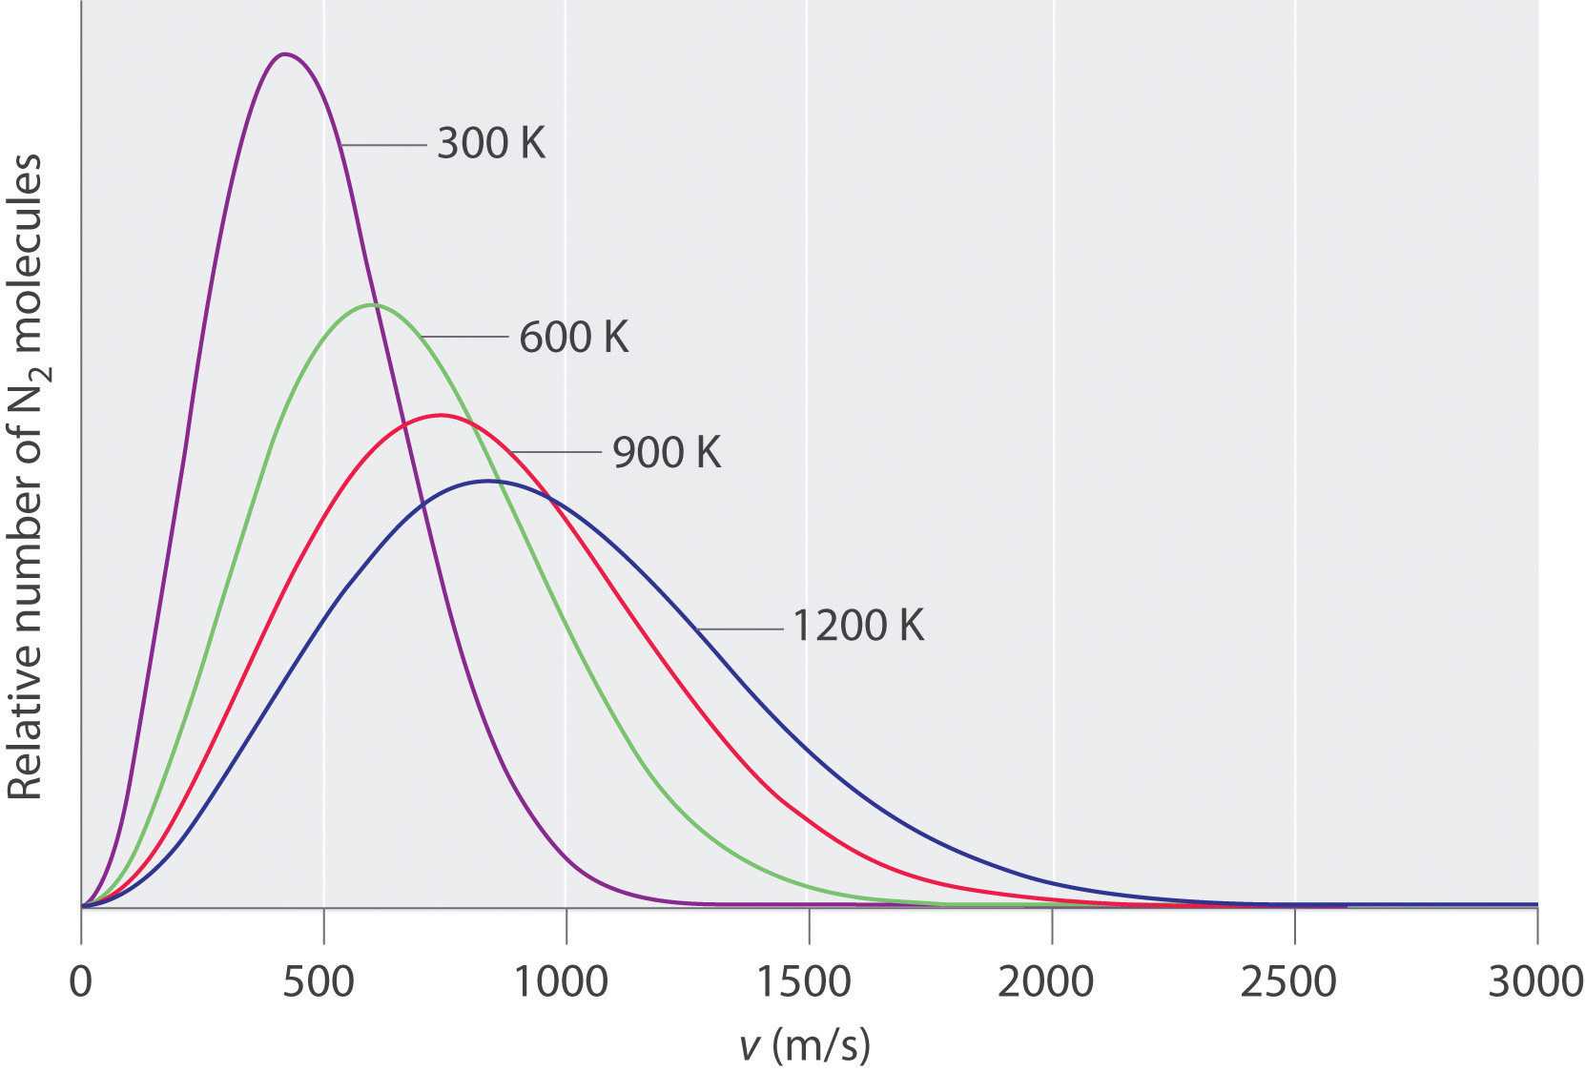
PROBABLE SPEED

Slide 4
